Slide 1


CS-2001 Data Structures Fall 2021 Graph Rerpesentations
Mr. Muhammad Usman Joyia
National University of Computer and Emerging Sciences,
Faisalabad, Pakistan.

Slide 2
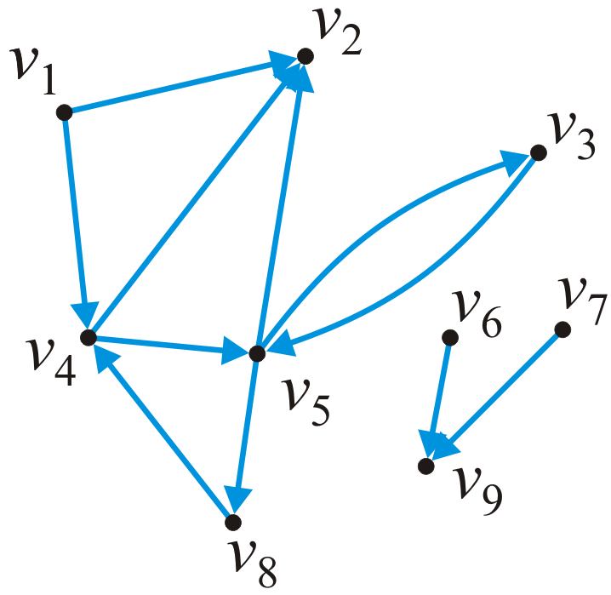
Representation
How do we store the adjacency relations?
Adjacency matrix
Adjacency list

Slide 3
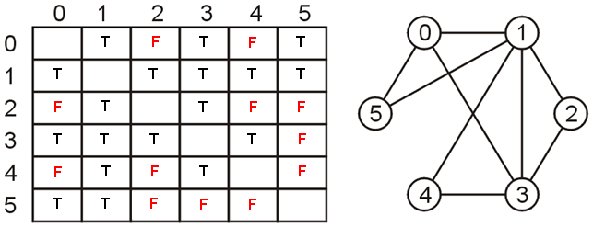
Adjacency Matrix
Two-dimensional matrix of size n x n where n = |V|
a[i, j] = 0 (F) if there is no edge between vertices v_{i} and v_{j}
a[i, j] = 1 (T) if there is an edge between vertices v_{i} and v_{j}
Adjacency matrix of undirected graphs is symmetric
a[i, j] = a[j, i]
F
F
F
F
F
F

Slide 4
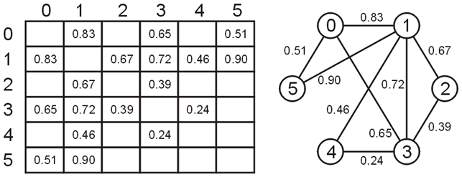
Adjacency Matrix – Weighted Graph
The matrix entry [j, k] is set to the weight of the edge (v_{j}, v_{k})
How to indicate absence of an edge in the graph?

Slide 5
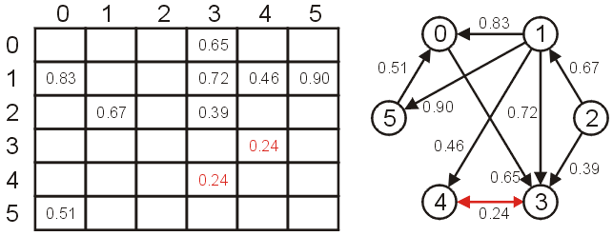
Adjacency Matrix – Directed Graph
For directed graph the matrix would not necessarily be symmetric

Slide 6
Adjacency Matrix – Analysis
Requires memory : O(|V|²)
Determining if v_{j} is adjacent to v_{k} : O(1)
Finding all neighbors of v_{j} : O(|V|)
 | 1 | 2 | 3 | 4 | 5 | 6 | 7 | 8 | 9
1 |  | 1 |  | 1
2
3 |  |  |  |  | 1
4 |  | 1 |  |  | 1
5 |  | 1 | 1 |  |  |  |  | 1
6 |  |  |  |  |  |  |  |  | 1
7 |  |  |  |  |  |  |  |  | 1
8 |  |  |  | 1
9

Slide 7
Adjacency Matrix – Problem
Very sparsely populated
Out of 81 cells only 11 are 1 (or T)
 | 1 | 2 | 3 | 4 | 5 | 6 | 7 | 8 | 9
1 |  | 1 |  | 1
2
3 |  |  |  |  | 1
4 |  | 1 |  |  | 1
5 |  | 1 | 1 |  |  |  |  | 1
6 |  |  |  |  |  |  |  |  | 1
7 |  |  |  |  |  |  |  |  | 1
8 |  |  |  | 1
9

Slide 8
Solution: Adjacency List
Each vertex is associated with a list of its neighbors
A vertex w is inserted in the list for vertex v if edge (v, w) exists
Requires memory : O(|V| + |E|)
1 • → 2 → 4
2 •
3 • → 5
4 • → 2 → 5
5 • → 2 → 3 → 8
6 • → 9
7 • → 9
8 • → 4
9 •

Slide 9
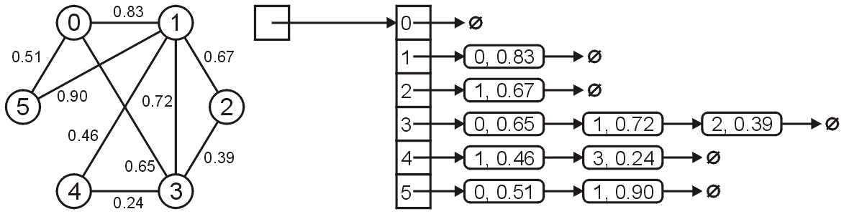
Adjacency List – Weighted Graphs
An adjacency list for a weighted graph contains two elements
First element for the vertex
Second element for the weight of that edge
When the vertices are identified by a name (i.e., string)
Hash-table of lists is used to implement the adjacency list
Array
Linked list

Slide 10
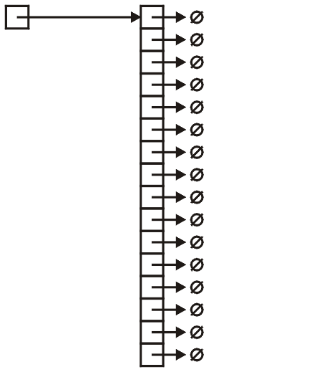
Adjacency List – Implementation
Node to store adjacent vertex and weight of the edge
class SingleNode {
private:
int vertex;
double edge_weight;
SingleNode * next_node;
};
Define and create Array
SingleNode **array;
array = new *SingleNode[16];

Slide 11
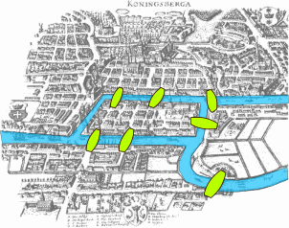
Graph Problems – Euler Tour
A sequence of vertices that traverse all edges in the graph exactly once
Leonhard Euler in 1736
Laid the foundations of graph theory
Problem: To devise a walk through the city that would cross each of the seven bridges of Königsberg once and only once
Notes:
The city of Königsberg (now Kaliningrad, Russia) was set on both sides of the Pregel River

Slide 12
Some classical problems in Graph theory

Slide 13

Graph Problems – Hamiltonian Cycle
Is there a simple cycle that connects all vertices in the graph
It is not necessarily mean that it should include all the edges.
As its a cycle, it should start and on same node
NP-Complete
Notes:
Euler cycle

Slide 14

Graph Problems – Hamiltonian Path
In Hamiltonian path visits all the vertices only once, but it does not need to end at the node where it started out
Knight’s Tour of chessboard
A sequence of knight’s moves
Visit every square of a chessboard precisely once
Closed and open tour
Close: If start and end at same square
Open: if it does not need to start and end
end at same square.

Slide 15
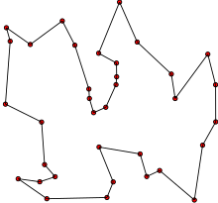
Graph Problems – Traveling Salesman
A salesman wishes to
Visit a number of towns, and then
Return to his starting town
Given the travelling times between towns, how should the travel be planned, so that:
He visits each town exactly once, and
He travels in as short time as possible
Problem: Given a weighted graph G, provide shortest cycle that contains all vertices in G
NP-Hard problem
Notes:
NP hard: just one condition, if every problem in NP is polynomial reduceable to it. It does not need be a proven NP problem. If both are true, then it shall be considered as NP-complete.

Slide 16
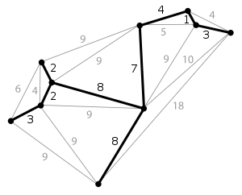
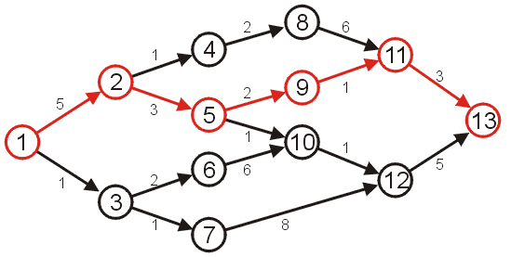
Graph Problems – Others
Minimum-cost spanning tree
Given a weighted graph G, determine a spanning tree with minimum total edge cost
Single-source shortest path
Given a weighted graph G and a source vertex v in G, determine the shortest paths from v to all other vertices in G

Slide 17
Any Question So Far?

